Slide 1
EDUNOVA-School
Management System
Team Details:
Adwita Jindal , 2310990268
Gunn , 2310990277
Aryan Bansal ,2310990303
Divya , 231099328
Class Group: G4
Chitkara University Institute of Engineering and Technology,
Chitkara University, Punjab

Slide 2
Introduction
This project is a multi-tenant school management platform developed using the MERN stack, aimed at simplifying academic and administrative processes. It allows schools to efficiently manage teachers, classes, and students while integrating features such as attendance tracking, fee management, complaint resolution, and notices. The system provides secure, role-based access for administrators, teachers, and students, ensuring privacy and smooth workflow. The platform is designed to be scalable, making it suitable for schools of different sizes and adaptable to evolving educational needs.

Slide 3
PROBLEM STATEMENT
Managing schools manually often leads to inefficiency, data loss, and communication gaps between administrators, teachers, students, and parents. Tasks like tracking attendance, managing fees, handling complaints, and issuing notices are time-consuming and prone to errors when done on paper or basic systems. Schools also struggle to maintain privacy, ensure secure access, and streamline workflows. There is a need for a centralized, user-friendly, and secure platform that simplifies school management while enhancing communication and efficiency.

Slide 4
KEY FEATURES
Manage Teachers, Students, and Classes
Add, edit, and maintain profiles of teachers and students.
Assign students to classes and teachers to subjects for organized management.
2. Attendance Tracking
Record daily attendance for students and teachers.
Generate reports to monitor participation and performance.
3. Complaint Handling
Submit and manage complaints from students, teachers, or parents.
Track resolution status to ensure timely action.

Slide 5
4. Notices and Announcements
Post school-wide notices for events, meetings, or important updates.
Ensure all stakeholders receive notifications promptly.
5. Role-Based Access
Secure access based on user type: administrators, teachers, students.
Ensures privacy and prevents unauthorized access to sensitive data.
6. User-Friendly Interface
Easy navigation for all users.
Reduces training needs and improves adoption among staff and students.

Slide 6
Tech Stack
1. Frontend:
React.js – For building a dynamic, responsive, and component-based user interface.
HTML, CSS, JavaScript – Core technologies for styling and interactivity.
2. Backend:
Node.js – Server-side runtime environment for handling requests and APIs.
Express.js – Web framework for building backend routes, middleware, and server logic.
3. Database:
MongoDB – NoSQL database for storing school, teacher, student, attendance, fee, complaint, and notice data.
Mongoose – ODM (Object Data Modeling) library for schema design and interacting with MongoDB.

Slide 7
4. Other Tools:
Nodemon – Auto-restarts server during development.
Postman – For testing APIs.
Git & GitHub – Version control and collaboration.

Slide 8
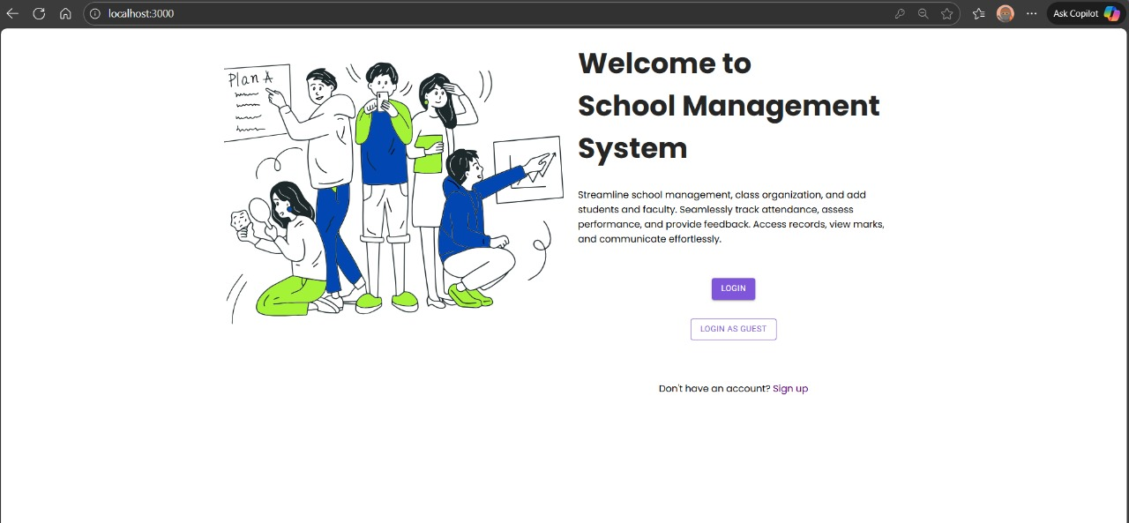
OUTPUT

Slide 9
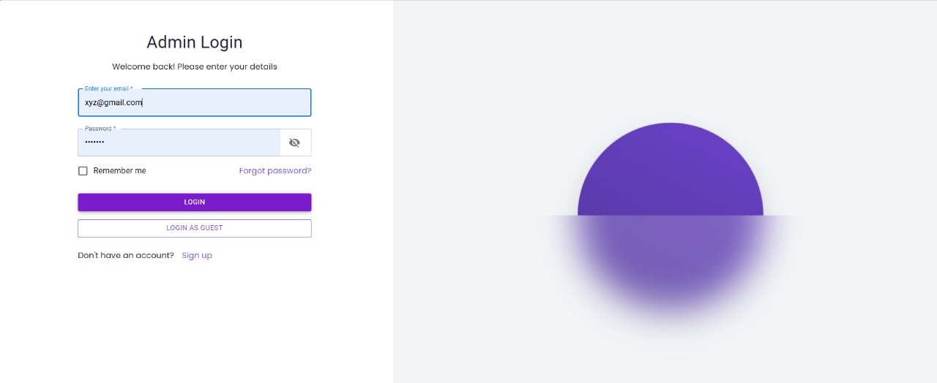

Slide 10
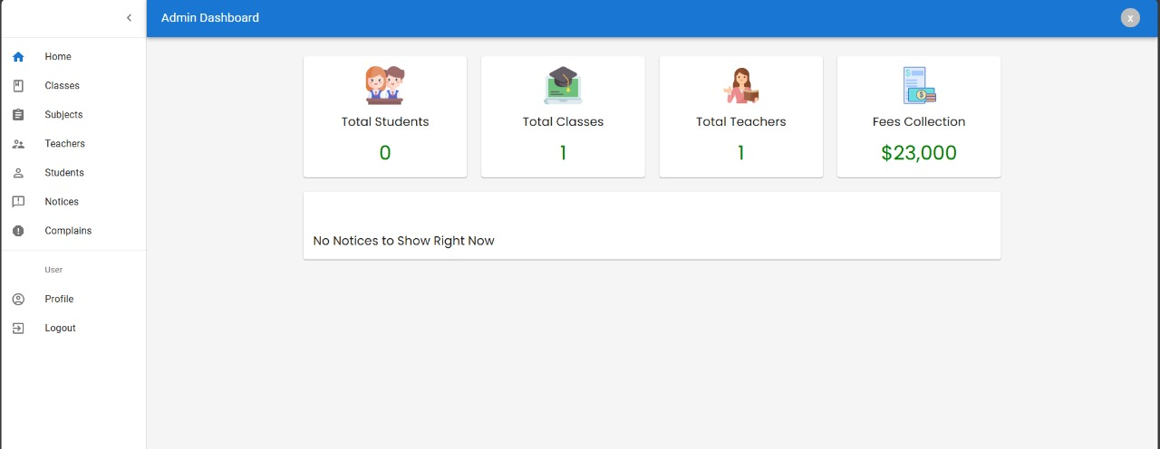

Slide 11
CONCLUSION
Provides a secure and efficient solution for school administration
Simplifies management of teachers, students, classes, attendance, fees, complaints, and notices
Ensures role-based access and data privacy
Built with a modern, scalable tech stack adaptable for schools of any size

Slide 12


